Slide 1
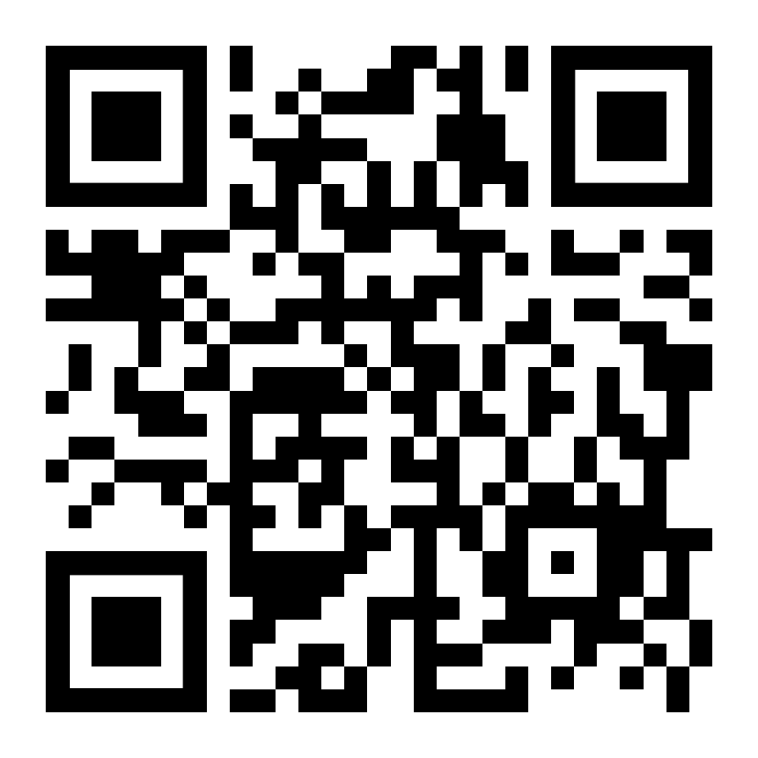

Slide 2
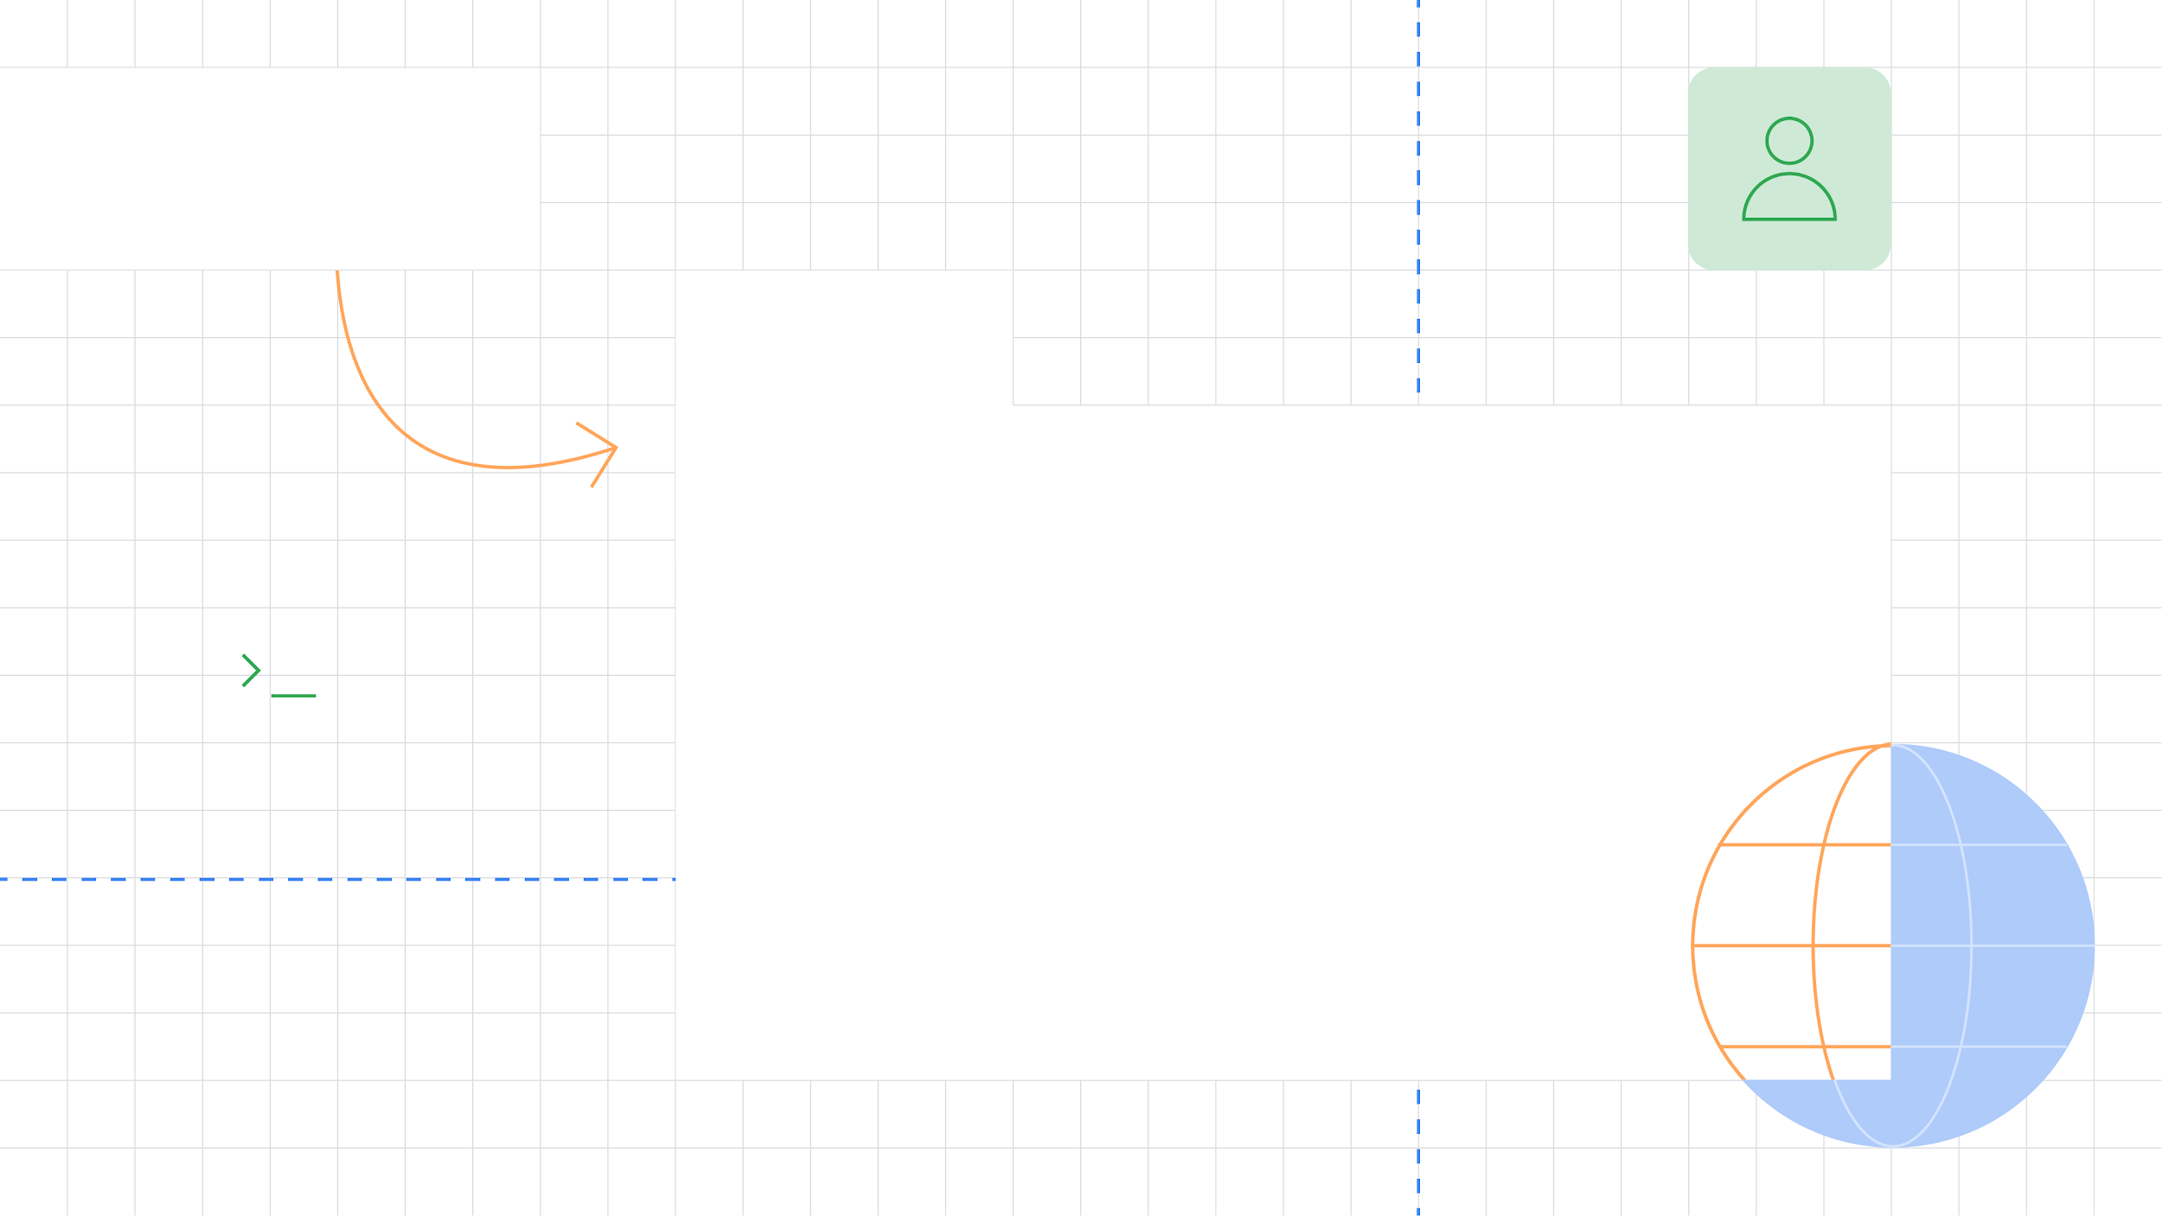



Deployment &
Maintenance
From Local builds and Beta Testing to Global Releases
Goran Luketić
GDG Osijek
Head of Development @COBE

Slide 3


Agenda
How to start? 🤔
Step by step 🪜
Deploy internally 🐛
Automatization 🤖
Release 🎉
What to do now? 🛠️
Q&A 🙋‍♀️🙋

Slide 4
Publishing is the general process that makes your Android application available to users.

Slide 5
Two simple steps

Slide 6
Prepare the application for the release 🛠️

Slide 7
2. Release the application to the users 🎉

Slide 8
Is it really? 🤔

Slide 9
How to start?
Questions that I might ask?
How should I build the app ready for release?
Usually I run the app in Android Studio, where to find the file needed to upload.
I have two options “build” and “build signed”. What is the difference?
I have two options APK and AAB? What to choose?
Did I tested it enough? Does it work on multiple devices, Android versions or screen resolutions?
Can I deploy it to my friends, or family before release?
How can I monitor the performance and issues if they occur?
Can I deploy it for free?

Slide 10
Step by step 🪜

Slide 11
Prepare for the release
Checklist
Choose an application ID that is suitable over the life of your app - You can't change the application ID after you distribute your app to users.
Turn off debugging, logging and clean up project directories for the files that are not being used.
Review AndroidManifest.xml. Only add required permissions for your app.
Set up android:icon and android:label
Prepare production server and resources
Version the application

Slide 12
Prepare for the release
Versions
versionCode - like name suggests, version code, must be greater than last one for the updates
versionName - version name - Semantic versioning (SEMVER) major.minor.patch
compileSdk - the version of the API the app is compiled against
targetSdk - a certification or sign off you are giving the Android OS as a hint to how it should handle your app in terms of OS features.
minSdk - minimum OS version to run the app
minSdkVersion <= targetSdkVersion <= compileSdkVersion

Slide 13
android {
namespace 'com.demo.ada.deployment'
compileSdk 35
...
defaultConfig {
minSdk 30
targetSdk 35
versionCode 1
versionName "1.0.0"
...
}
buildTypes {
release {
isDebuggable = false
...
}
debug {
isDebuggable = true
...
}
}
...
}

Slide 14
Build the application
.apk vs .aab
AAB (Android App Bundle)
publishing format
optimized APKs for each user’s device configuration
smaller and more optimized downloads
APK (Android Application Package)
packaging format which will be installed on the device

Slide 15
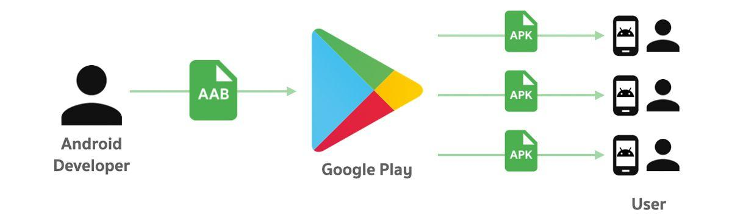
Build the application
.apk vs .aab

Slide 16
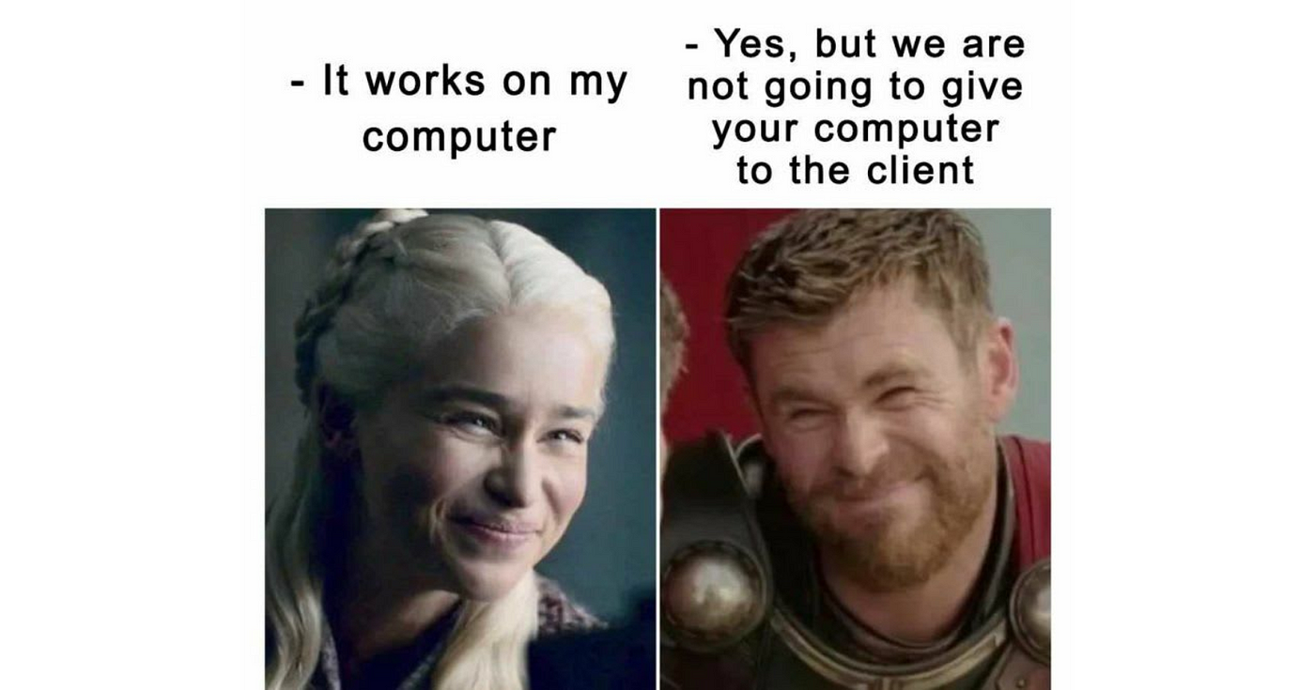
I’ve built my application with option: “Build APK(s)” but installation fails on the device, what to do?

Slide 17

Android requires that all APKs are digitally signed with a certificate before they are installed on a device or updated

Slide 18
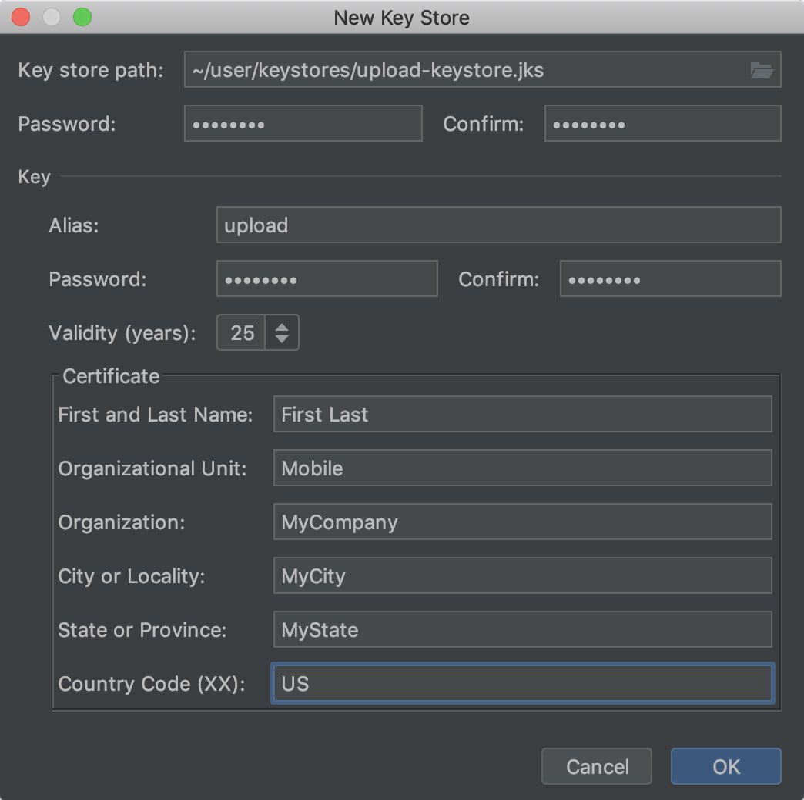
Signing the application
Unsigned vs Signed Application
Unsigned App
Only the Developer has unsigned APK.
Generated when we are testing our app.
Actually signed by debugging key.
Signed App
Signed with your own key which is guarded by you.
Generated when we are releasing the App.

Slide 19
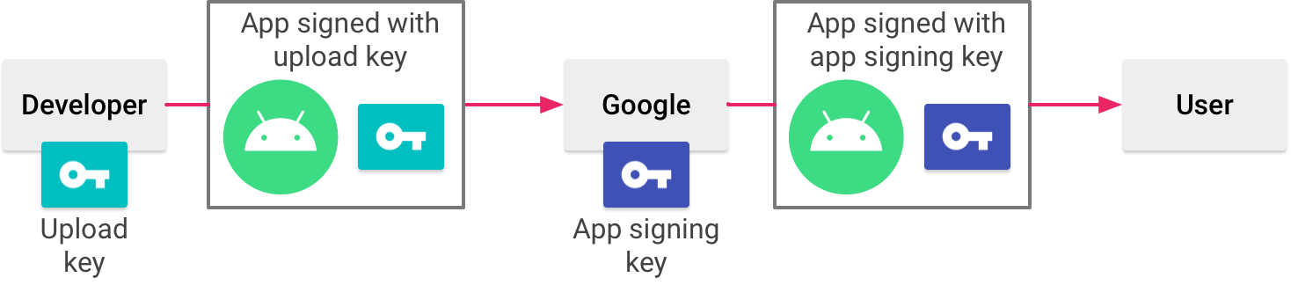
Sign the application

Slide 20
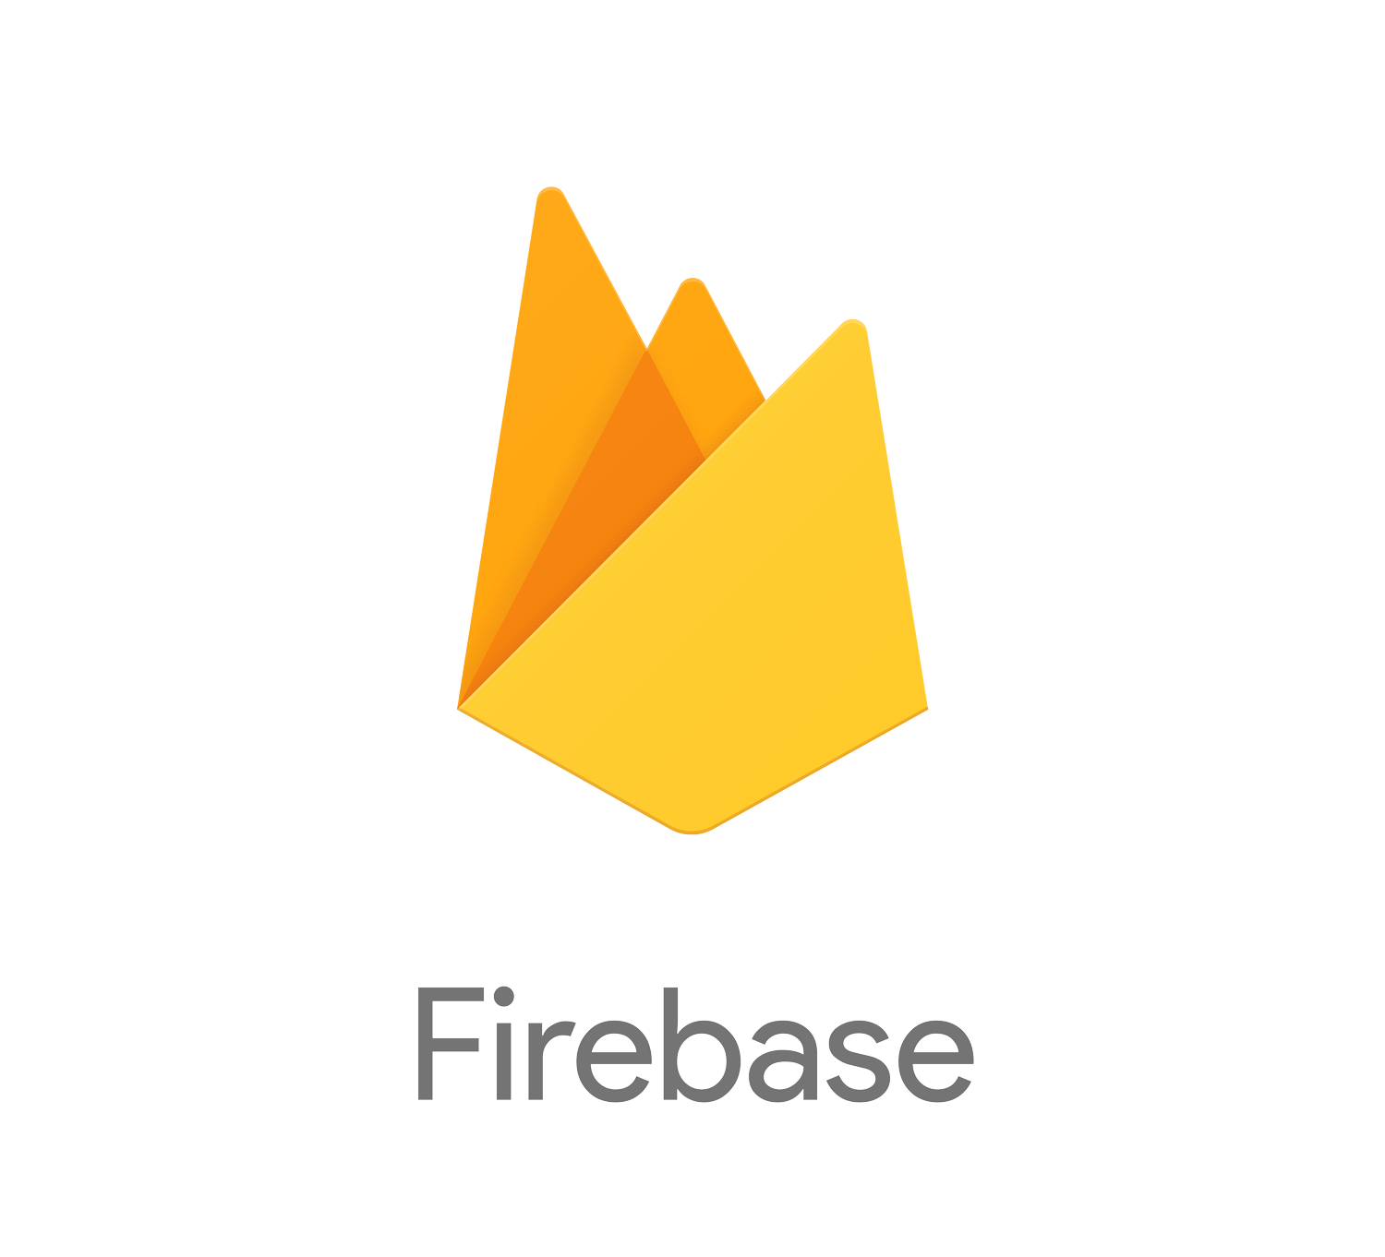
Deploy internally

Slide 21

Firebase App Distribution
Distribute pre-release versions of your apps to your trusted testers

Slide 22
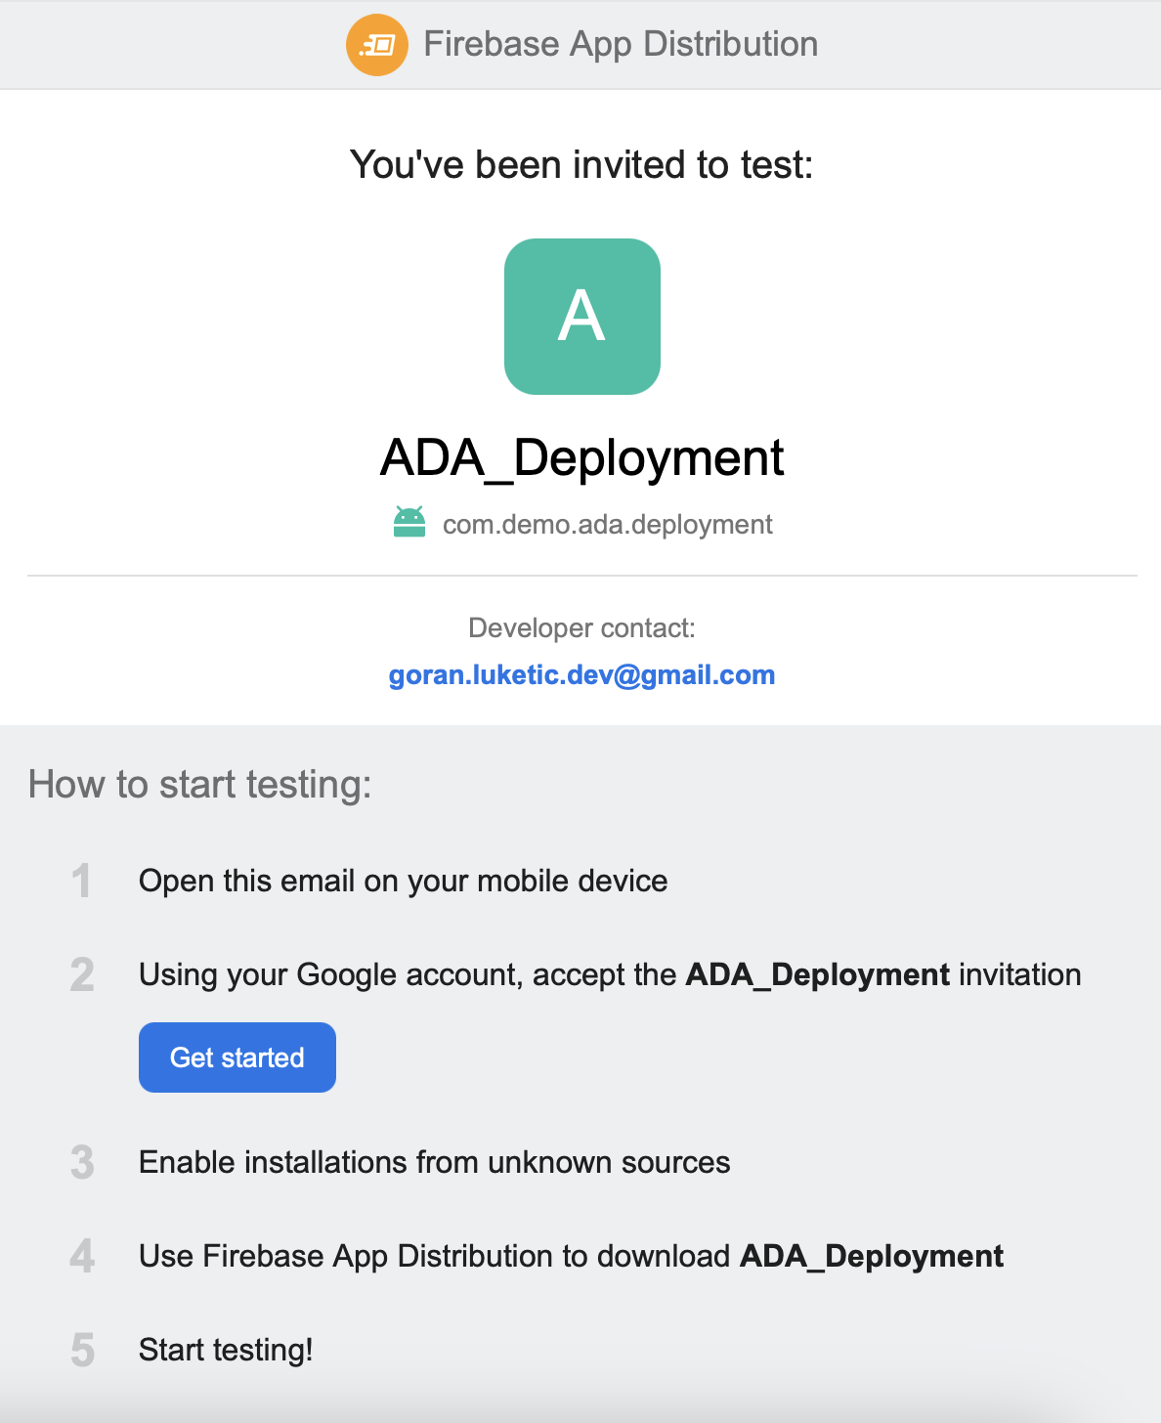
Firebase App Distribution
Benefits
It's easy for QA to switch to previous releases
versionCode doesn’t need to increment
Instant availability
Testing
Firebase App Distribution
Device Lab
AppTester app
Monitoring and logs
Firebase Crashlytics
Alerts when new build is ready
Easier to automate
Manage multiple environments (flavors)
Package name is changeable (if app is not yet on Google Play)

Slide 23
Demo

Slide 24
Do I have do it manually? 🤖

Slide 25
Distribution Automation
GitHub Actions

Slide 26
Distribution Automation
Prerequisites
Firebase project created
Firebase application created with matching package name
Create Github Actions .yml file
install firebase cli on your device (curl -sL https://firebase.tools | bash)
Run: firebase login:ci
Login with the Firebase (Google) account

Slide 27
name: Firebase App Distribution
on:
push:
branches:
- main # Or your release branch name
workflow_dispatch: # Enable manual triggering
jobs:
build-and-distribute:
name: Build and Distribute to Firebase App Distribution
runs-on: ubuntu-latest
steps:
- name: Checkout code
uses: actions/checkout@v3
- name: Set up JDK 17
uses: actions/setup-java@v3
with:
java-version: '17'
distribution: 'temurin'
cache: gradle
- name: Make gradlew executable
run: chmod +x ./gradlew
- name: Build Release APK
run: ./gradlew assembleRelease
- name: Sign Android release
uses: r0adkll/sign-android-release@v1
with:
releaseDirectory: app/build/outputs/apk/release/
signingKeyBase64: ${{ secrets.KEYSTORE }}
alias: ${{ secrets.ALIAS }}
keyStorePassword: ${{ secrets.KEY_STORE_PASSWORD }}
keyPassword: ${{ secrets.KEY_STORE_PASSWORD }}
env:
BUILD_TOOLS_VERSION: "34.0.0"
- name: Firebase App Distribution
uses: wzieba/Firebase-Distribution-Github-Action@v1
with:
appId: ${{ secrets.FIREBASE_APP_ID }}
token: ${{ secrets.FIREBASE_TOKEN }}
groups: ${{ secrets.FIREBASE_TESTERS_GROUP }} # Optional
file: app/build/outputs/apk/release/app-release.apk
releaseNotes: "New release pushed from GitHub Actions"

Slide 28
Demo

Slide 29
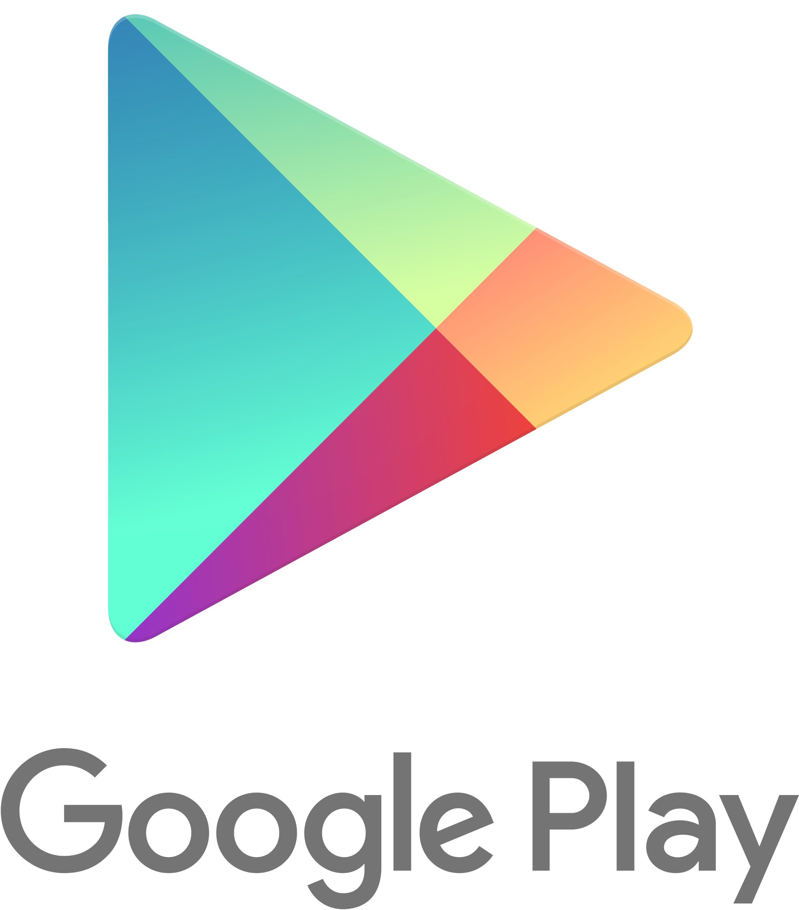
Google Play Release Process
Show your application to the world

Slide 30
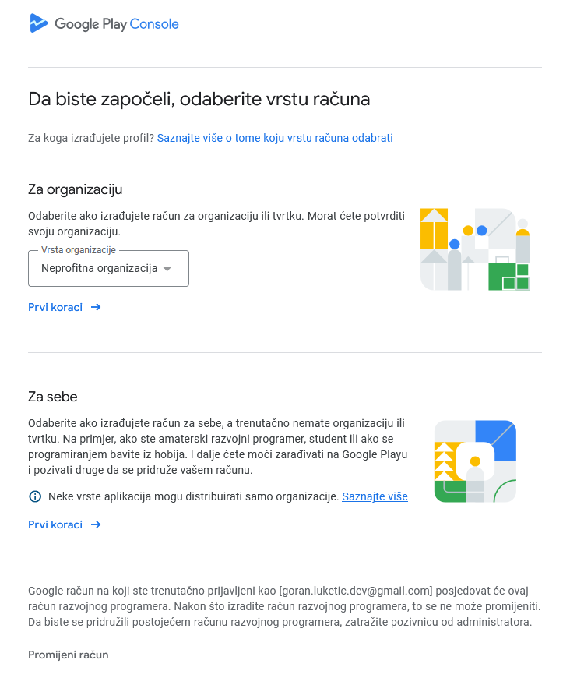
Google Play Console
Manage your apps and games on Google
Create the account
Add personal details
Pay 25 USD
Verify Account (upload personal documents)
Account verified 🎉

Slide 31
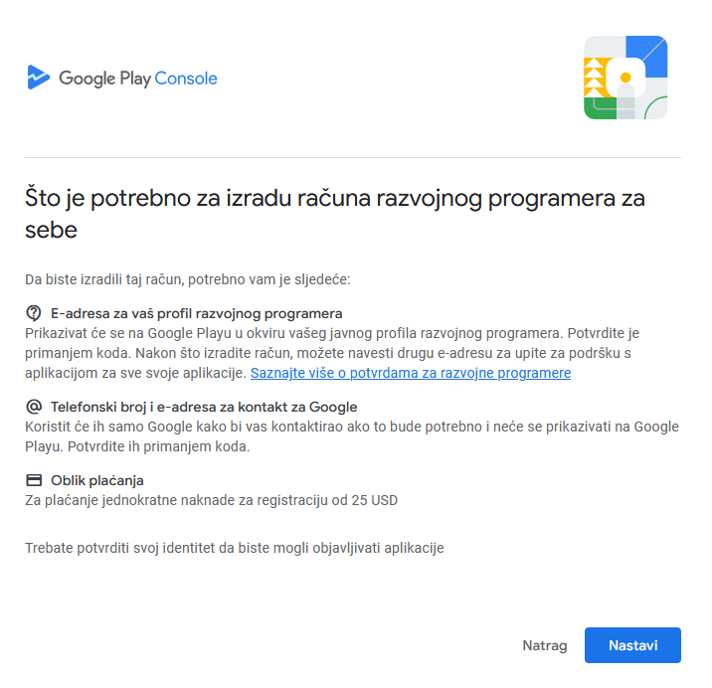

Slide 32
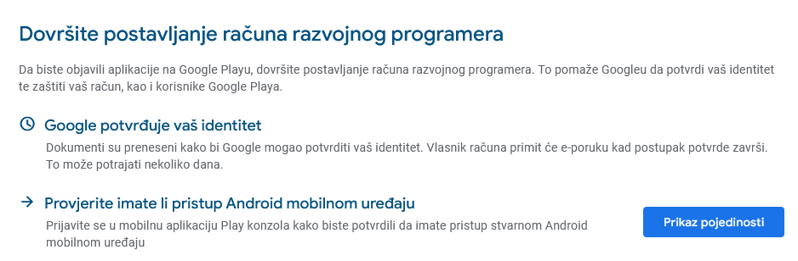
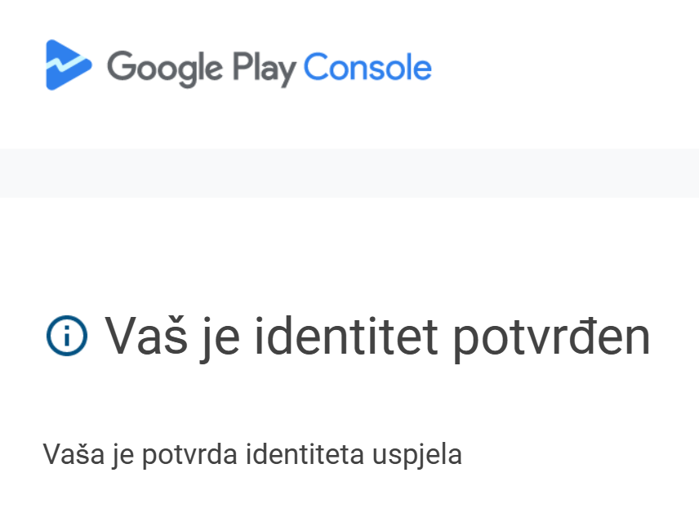

Slide 33
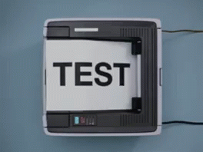
Create your first app
Mandatory information about the app
Name
Language
Type - (App/Game)
Free/Paid
Accept terms

Slide 34
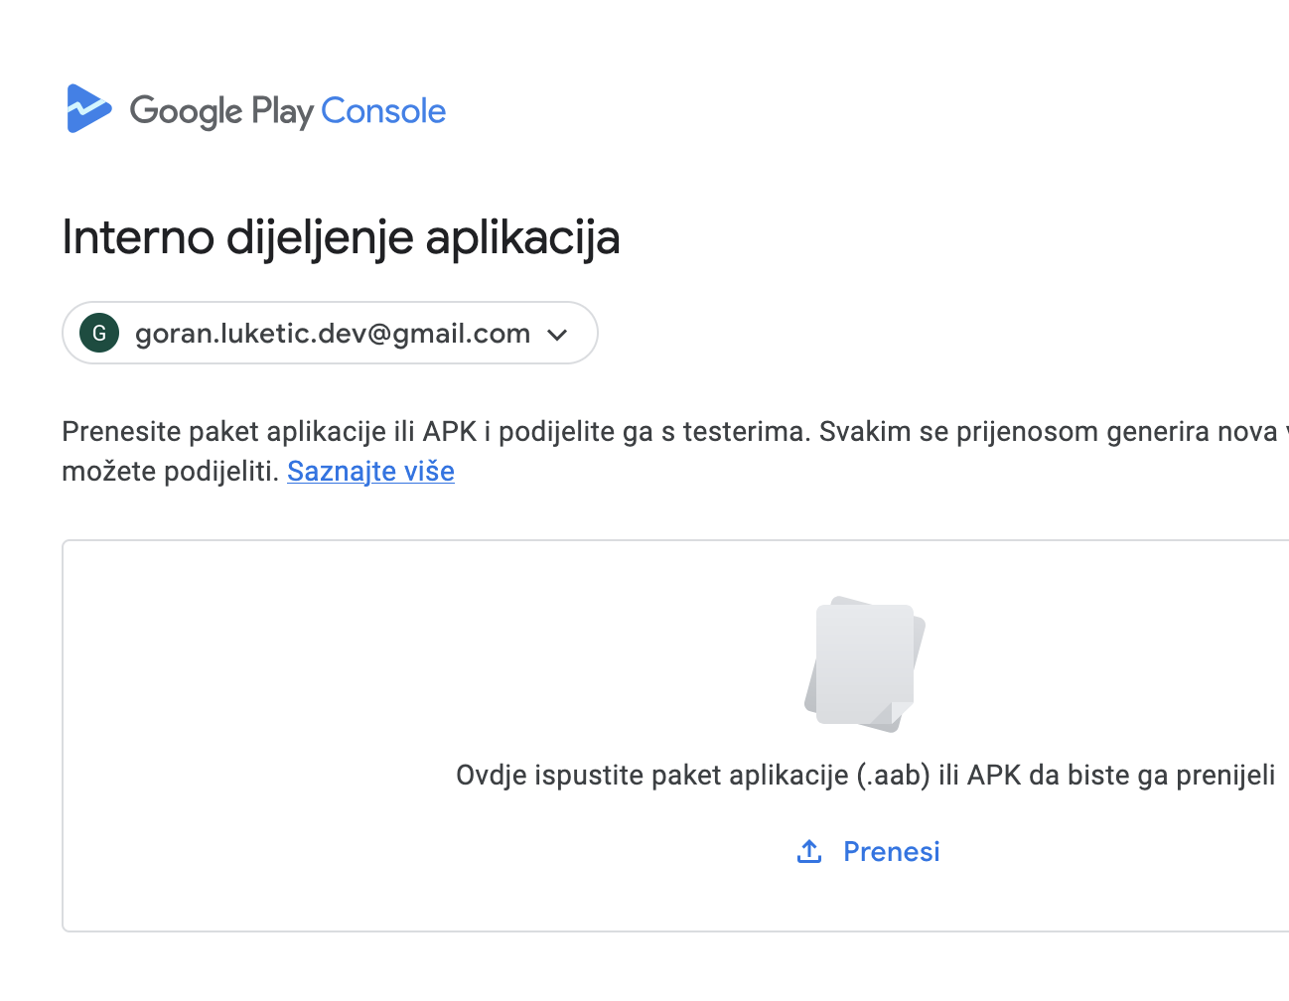
Google Play Test tracks
Open testing
Publicly available to everyone
Closed testing
closed testing with groups of testers
a larger number of users
the app must pass a review
email list + Google groups
Internal testing
up to 100 testers, no review
about an hour to propagate
email list

Slide 35
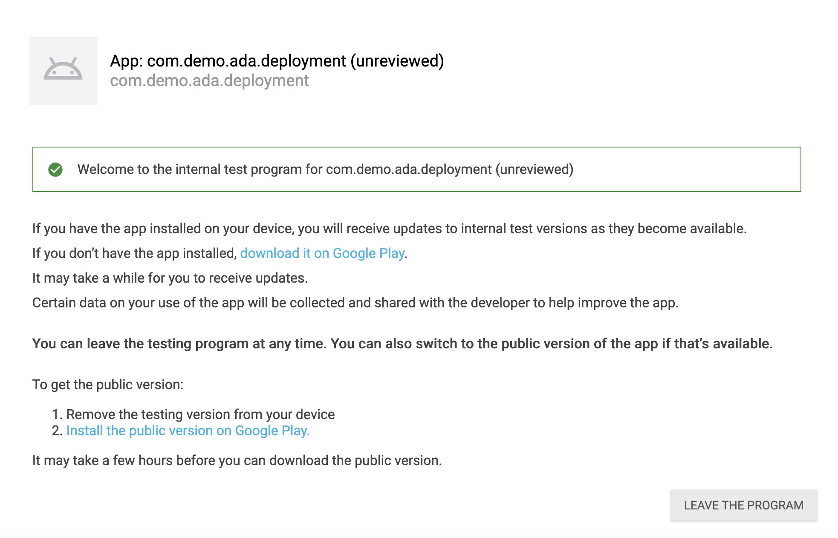

Slide 36
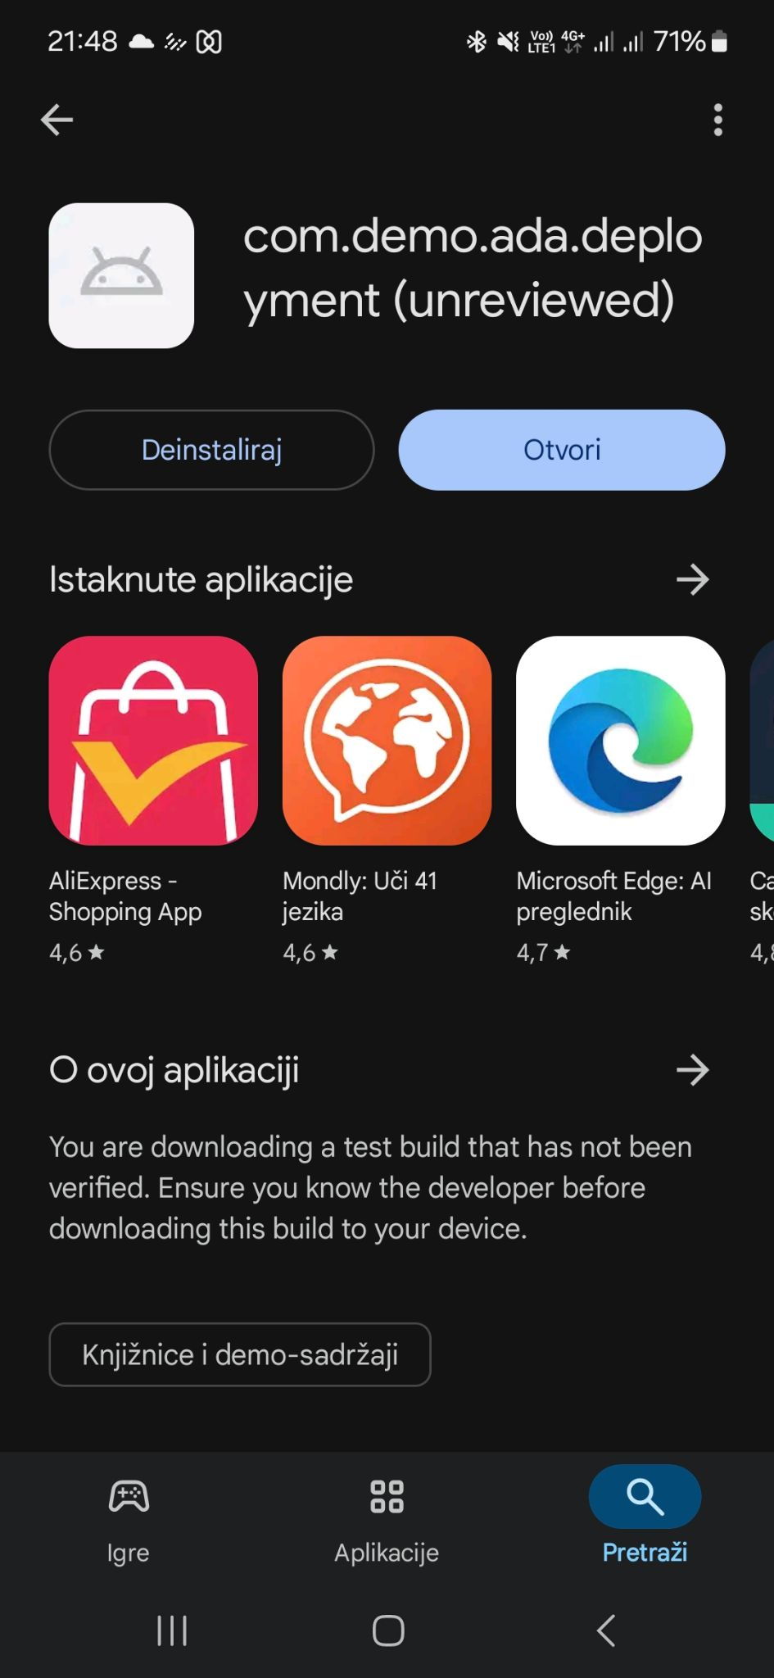

Slide 37
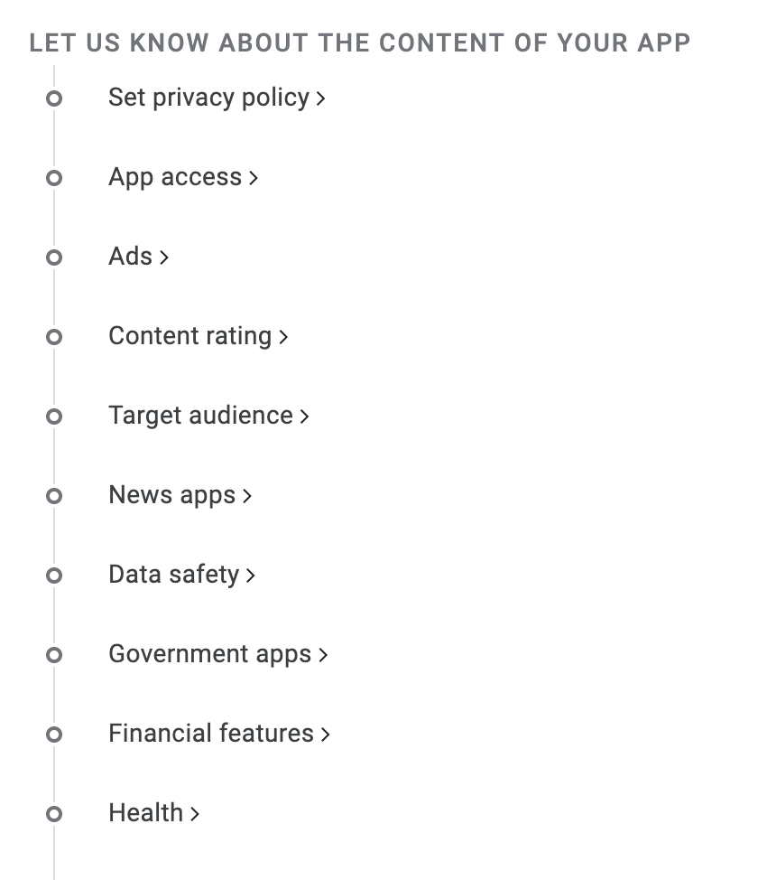
Create your first app
Store listing mandatory fields
App name
Short description (80)
Full description (4000)
Icon (512x512)
Promo graphic (1024x500)
2 - 8 screenshots , tablet optional, chromebook
Possible to add multiple languages - separate store listing

Slide 38
Demo

Slide 39
Release 🎉

Slide 40
App is released! What to do now?

Slide 41
Maintenance
Why it matters?

Slide 42
Maintanance
Prepare and Update for New Android Versions
Update Libraries and Dependencies
Continuous development of new features
Collect feedback from users and use crash reporting tools (e.g., Crashlytics) to identify and fix issues.
Develop
Deploy
Test

Slide 43
Summary
Prepare the application for the release - Checklist
Build signed release
Upload for internal testing
Create Google Play Account
Prepare store listing with all mandatory application info
Publish to test (optional)
Release 🎉
Monitor & Maintain 😎

Slide 44
Literature
Play App Signing
Android App Bundles
Firebase
Google Play Console

Slide 45
Q&A 🙋‍♀️ 🙋‍♂️

Slide 46
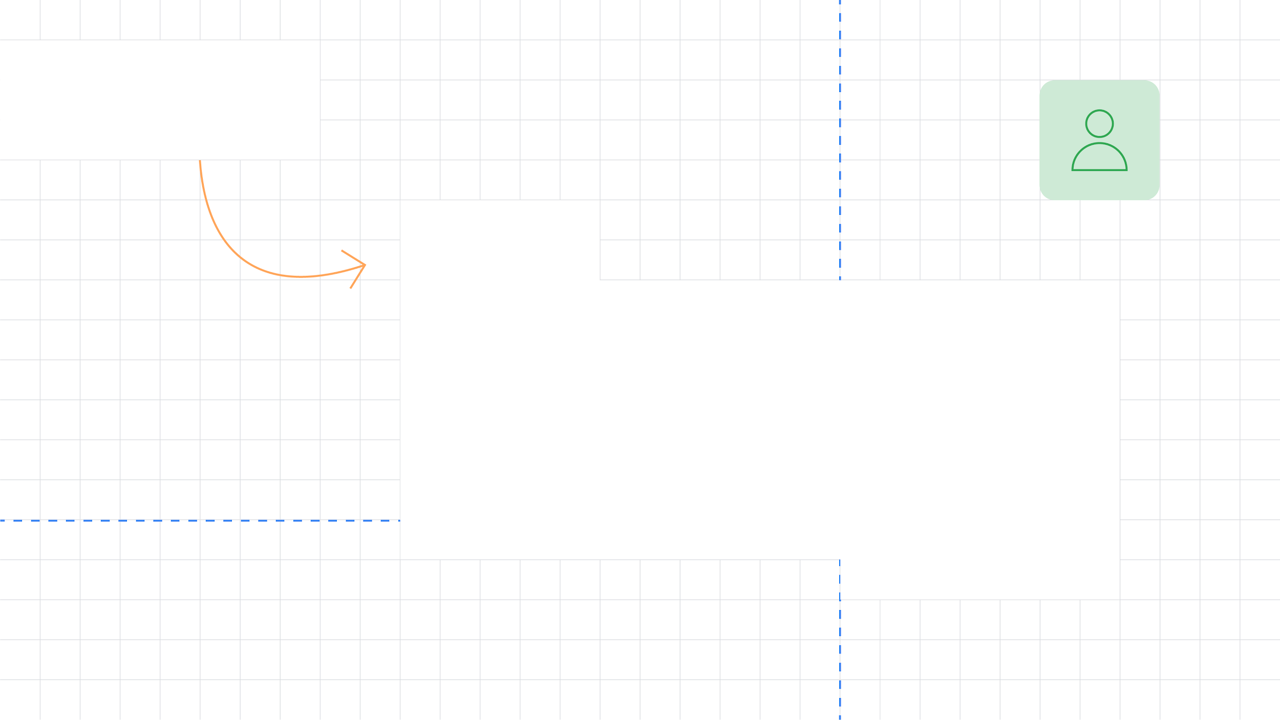
Thank You!
Goran Luketić
GDG Osijek
Head of Development @COBE

